Slide 1


INT355 ML PROJECT CUSTOMER CHURN PREDICTION USING MACHINE LEARNING
Name: Vishnu Srikar Manchem Registration No. : 12112382 Section: K21UW Roll No. : RK21UWB44
Notes:
Are your classroom colors different than what you see in this template? That’s OK! Click on Design -> Variants (the down arrow) -> Pick the color scheme that works for you!
Feel free to change any “You will…” and “I will…” statements to ensure they align with your classroom procedures and rules!

Slide 2
Abstract
In the telecommunications sector, customer churn detection stands as a critical area of study, pivotal for businesses in retaining their existing clientele. Churn, denoting the loss of business due to competitors' offers or network-related issues, prompts customers to terminate their service memberships.
The churn rate profoundly impacts both the duration of service and a company's future revenue, thereby significantly influencing the lifetime value of a client. Given its direct bearing on industry revenue, organizations are actively seeking predictive models capable of anticipating client attrition.
This study presents a machine learning-driven approach to churn prediction, leveraging algorithms to forecast customers likely to discontinue their subscriptions. By harnessing the power of machine learning, businesses can proactively identify at-risk customers, enabling tailored interventions to enhance service quality and mitigate churn.
The models employed in this project encompass a diverse array of machine learning techniques, including Random Forest, Support Vector Machine, Logistic Regression, K-Nearest Neighbors, Decision Tree, and Naive Bayes.
Feature engineering techniques are employed to extract relevant features from the data source, enhancing the model's predictive performance.
Validation of the predictive model is conducted using performance metrics such as accuracy, precision, recall, F1-score and receiver operating characteristic (ROC) analysis.

Slide 3
Problem Description
The aim of this study Provide actionable insights and recommendations to telecom companies for reducing churn rate and improving customer retention.
The core focus of this study is to develop and compare diverse machine learning models tailored for predicting customer churn within the telecommunication sector
Additionally, it seeks to meticulously assess the efficacy of various machine learning algorithms in accurately forecasting churn patterns..
Ultimately, the study endeavors to furnish telecom companies with actionable insights and strategic recommendations aimed at curbing churn rates and enhancing customer retention strategies.

Slide 4
Data Overview
In late 2009 and early 2010, the United States undertook the National Telecommunications Customer Survey, aimed at understanding customer behaviors and preferences within the telecom industry. This comprehensive phone survey delved into various aspects, including telecom service usage, satisfaction levels, and preferences for plans and pricing
The National Telecommunications Customer Survey also probed respondents about their social, economic, and demographic backgrounds, along with their views on illness risks, vaccine efficacy, and transmission mitigation behaviors. This holistic approach enriched insights for telecom companies to tailor services effectively.
Data source: The telecom survey data was sourced from the Telecom Data Institute, a leading authority in telecommunications research and analysis, ensuring robust and reliable findings.
https://www.kaggle.com/code/farazrahman/telco-customer-churn-logisticregression/notebook
The telecom survey data explores customers' subscription status and usage patterns, alongside their demographic, behavioral, and satisfaction factors.
The total number of responses in the provided telecom dataset is 7043, offering a substantial amount of data for analysis and insights.

Slide 5
Methodology
Out of the 21 columns in the dataset, only relevant features were retained for prediction purposes. The customer_ID column was excluded from the analysis, resulting in a streamlined dataset ready for predictive modeling with 20 relevant columns. Additionally, columns such as MonthlyCharges, InternetService, and Contract were selected for their importance in predicting customer behavior and satisfaction.
After dropping the rest of the features,20 features were left for model building.
Data Cleaning:
Checking Null Values:
There are no null values found in the dataset so proceed accordingly.
Dropping Column :
Dropping the column which is not used for the model building and proceed after this.

Slide 6
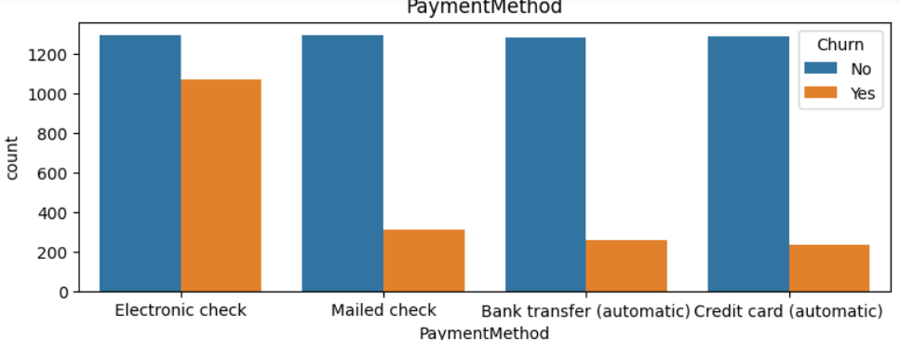
Methodology
Exploratory Data Analysis
PaymentMethod
More than 1000 have done payment through Electronic check.

Slide 7
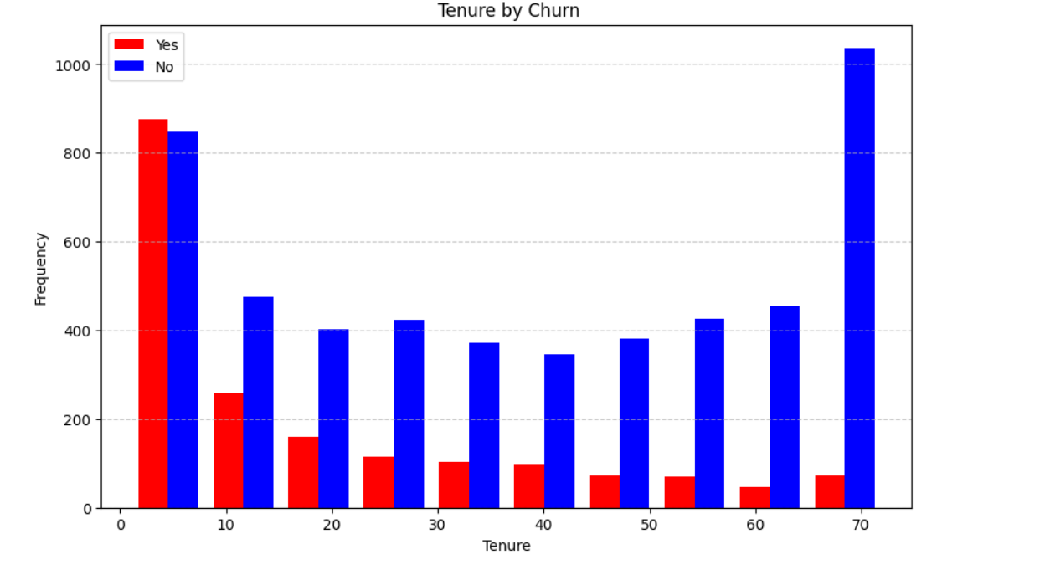
Methodology
Exploratory Data Analysis
Tenure by customer
The number of non-churned customers (blue bars) remains relatively consistent around 400-500 across different tenure values from 10 to 60.
At tenure of 70, there are around 900 non-churned customers (tall blue bar) and only around 100 churned customers (short red bar), indicating high retention for longer-tenured customers.

Slide 8
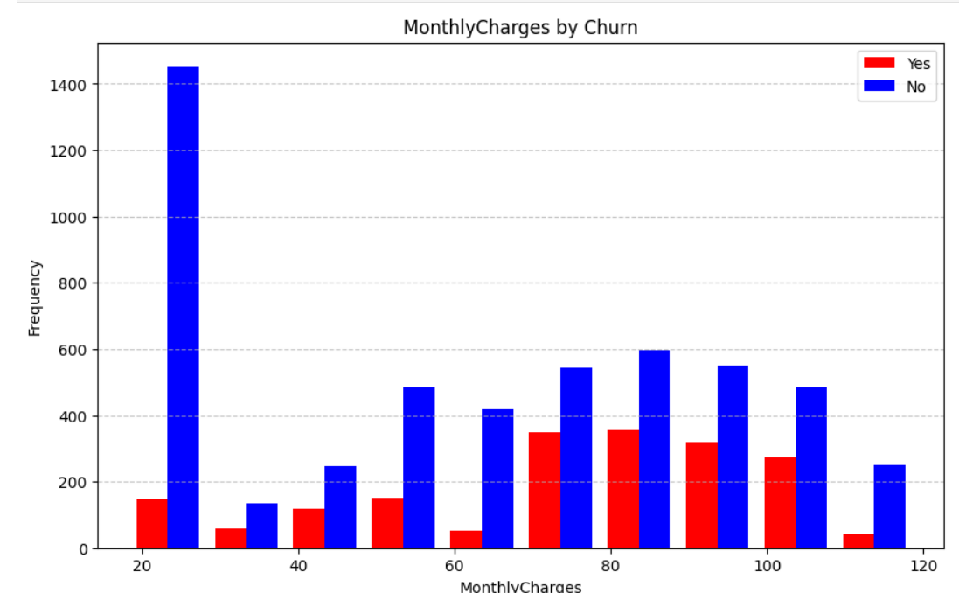
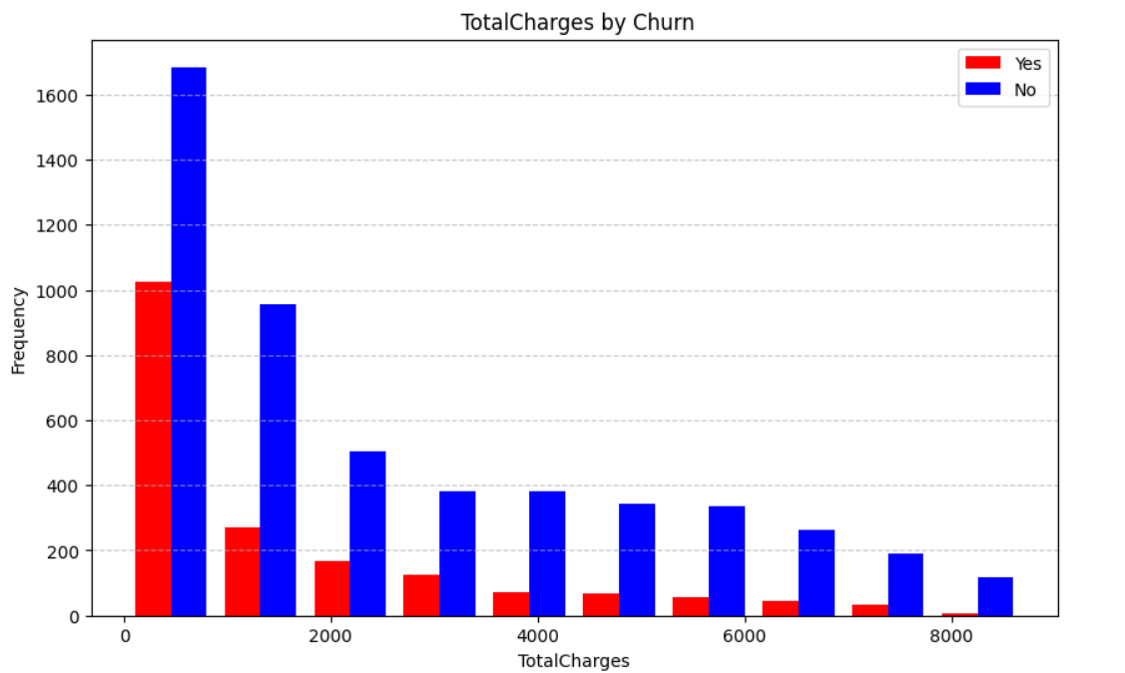
Methodology
Exploratory Data Analysis
Montly Charges by Customer
Higher monthly charges (> 60) correlate with increased customer churn, evident in taller red bars compared to shorter blue bars, indicating a potential influence of pricing on churn rates.
Total Charges by Customer
Beyond 4000 in total charges, a reversal occurs in the trend, with notably taller blue bars representing customers not churning, in contrast to shorter red bars indicating churned customers.

Slide 9
Methodology
Model Evaluation
The training and testing data was split in the ratio of 80:20.
A variety of different models were applied to find the most accurate model.
First the accuracy score, precision score, f1 score, recall and roc-auc curve was examined for each model without any hyperparameters.
After that hyperparameters were tunned.
To find the hyperparameters for each
model GridSearchCV was used to find
the best combinations for each model.

Slide 10
Results
Before Hyperparameter Tunning
After Hyperparameter Tunning
1. Logistic Regression
Test accuracy 0.73
2. Decision Tree
Test accuracy 0.753
3. Random Forest
Test accuracy 0. 795
4. Bernoulli Naive Bayes
Test accuracy 0.7796
1. Logistic Regression
Test accuracy 0.907
2. Decision Tree
Test accuracy 0.94
3. Random Forest
Test accuracy 0.95
4. Bernoulli Naive Bayes
Test accuracy 0.7796

Slide 11
Results
Before Hyperparameter Tunning
After Hyperparameter Tunning
6. Gaussian Naive Bayes
Test accuracy 0.7135
7. KNN classifier
Test accuracy 0.753
6. Gaussian Naive Bayes
Test accuracy 0.935
7. KNN classifier
Test accuracy 0.982

Slide 12
Conclusion
Through experimental results, it was observed that all models performed well, achieving high accuracies in predicting telecom customer churn.
K-Nearest Neighbors (KNN) achieved the highest test accuracy of approximately 98.48% after hyperparameter tuning.
Models like Random Forest and SVM might offer high accuracy but can be computationally expensive, especially with large datasets. KNN, while performing well, might face scalability issues with increasing data volume.
In conclusion, the implementation of accurate churn prediction models empowers telecom companies to strategically address customer retention, ultimately fostering higher satisfaction levels and stronger customer loyalty

